Slide 1

RESEARCH POSTERS
This document contains:
PAGE 2: tips for designing an academic poster with design and content recommendations
PAGE 3: a basic outline of how you might structure a research poster – you are welcome to use this as a guide or template
PAGE 4-6: branded blank poster templates with editable text and moveable logos – you are welcome to use these, but it is not required for Research Day
PAGE 7: Bruyère Health Research Institute official logos
PAGE 8: brand fonts and sizing tips
PAGE 9: brand colour palette

Slide 2
DESIGN & CONTENT TIPS
This is a 4’ x 3’ poster when printed. Font sizes below 32pt will be difficult to read when printed!
If you find your content is overflowing the recommended space, do not decrease font size – your audience will not stop to read more. Find the key points and CUT the remainder.
Tight and long blocks of text impede readability. Don’t try to fill all white space, give your content some breathing room so the audience can easily understand how to move from one segment to the next.
Not every graph/chart from your analysis needs to be included – select the most relevant that convey the key findings.
Check out Creating an Academic Poster: Tips and Tricks for recommendations on content structure, font sizes, and how to effectively present and incorporate visuals such as charts and diagrams.
Use QR codes to link out to full publications, your website, or contact information. Generate one for free at QR Code Generator by Bitly.

Slide 3

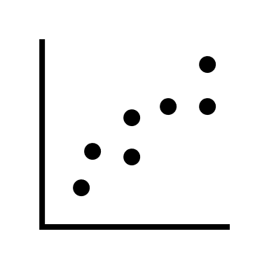



Anatomy of a Research Poster
Name 1, Name 2, Name 3
BACKGROUND
RESULTS
OTHER CONSIDERATIONS
Explain why the study matters in simple terms. What health challenges prompted this work? Why are you investigating this question?
Your findings should take up the majority of the space. The more you are able to use plain English, the wider an audience you can reach!
Distill the key ideas. What did you discover? What are the results and what are their impact?
What do these findings mean for patients, your population of interest, health care providers, the health system, or the broader field of study?
Any other results, graphs, tables, or nuance you can’t capture with the main findings can have the remainder of the space.
Anything worth discussion about future directions? Limitations? Any other considerations about this work?
METHODS
Include your study population/sample, brief method collection, and what processes you used for analysis. Add a flowchart or visualization if possible.
You don’t need to include every detail. Be concise.
Visualize findings with an image, graph, or figure.
Help people navigate your ideas by avoiding visually crowded posters and only speaking to the most essential points.
Add references, affiliations/partners, extra logos, acknowledgements, contact information, etc. at the bottom.

Slide 4
Research Poster Template
Name 1, Name 2, Name 3
Headers are sized at 44
Text is sized at 36.

Slide 5
Research Poster Template
Name 1, Name 2, Name 3
Headers are sized at 44
Text is sized at 36.

Slide 6

Research Poster Template
Name 1, Name 2, Name 3
Headers are sized at 44
Text is sized at 36.

Slide 7



LOGOS
DO NOT CROP OR MODIFY LOGOS. Resize in the original proportions only.
Please review the Bruyère Health Brand Guide for more information on logo, fonts, design elements and colour palettes.

Slide 8
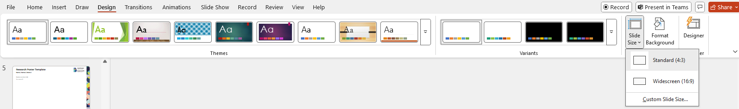

FONTS
Bruyère Health uses Montserrat font, which can be downloaded here, if your applications are not already equipped with it.
This file is a 4’ x 3’ (48” x 36”) poster when printed. You can check the poster’s final dimensions by going to the Design tab and selecting Custom Slide Size.
Keep in mind your audience is not standing right up against the poster to read. Font sizes below 32pt will be difficult to read if viewers are standing more than a couple of feet away. See the Design & Content Tips page for resources on font sizing.
For reference, this box will be 1” x 1” when printed and this text is font size 60.
Please review the Bruyère Health Brand Guide for more information on logo, fonts, design elements and colour palettes.

Slide 9
BRAND COLOURS
When using brand colours, please ensure you have enough contrast between background and foreground (e.g. text on background) for clear visibility. You may wish to check contrast with this accessibility tool: https://www.audioeye.com/color-contrast-checker/
Please review the Bruyère Health Brand Guide for more information on logo, fonts, design elements and colour palettes.
HEX #AD4643
HEX #DB7365
HEX #F2CFB4
HEX #1D5555
HEX #5CBAB7
HEX #C5E0DD
HEX #334664
HEX #2B3F82
HEX #C9C6D3
HEX #292544
HEX #607EAC
HEX #B8C4D6
HEX #E0DA47
HEX #231F20
HEX #FFFFFF

