Slide 1
UPDATE :
Disorders of Gut-Brain Interaction
(DGBI)
Dr. Heather Boudreau MD FRCPC
Sept 6th 2023
Pan-Northern Clinical Rounds

Slide 2
Disclosure of Affiliations, Financial and In-kind Support
Affiliations:
  Speaker: Takeda, Abbvie, Janssen
  Research: PI for Sudbury site of new probiotic for IBS – Nestle
  Advisory Boards: Fresenius Kabi
Financial Support: Sudbury MD LEG

Slide 3
OBJECTIVES
What are Disorders of Gut-Brain Interaction (DGBI)?
Acknowledge the huge unknowns in the world of DGBI
Update in Functional Dyspepsia
Update in Irritable Bowel Syndrome
Update in Chronic Constipation
How to approach these disorders with the patient
What about Diet?

Slide 4

What are Disorders of Gut-Brain Interaction?
Formerly called ‘Functional Disorders’
‘Symptom Clusters’ with limited findings on diagnostic tests
Caused by:
  altered motility
  visceral hypersensitivity
  changes in the epithelial barrier of the gut
  mucosal immune dysfunction
  microbiome disturbance
  Gut- CNS neural processing

Slide 5
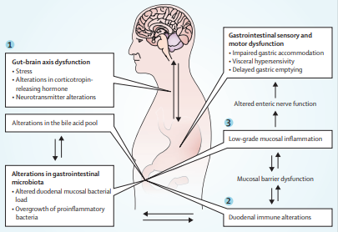
FUNCTIONAL DYSPEPSIA

Slide 6
DYSPEPSIA
‘My food won’t digest’
‘I always feel a fist or ball in my stomach after eating’
Pain referred to the gastroduodenal area
80% will not have a structural cause ‘Functional Dyspepsia’
Not:
  Dysphagia
  Heartburn
  Pain radiating to the back
  …
‘It burns after I eat’

Slide 7
FUNCTIONAL DYSPEPSIA (FD)
‘My food won’t digest’
‘I always feel a fist or ball in my stomach after eating’
ROME DEFINITION: More than 1 of:
Post-prandial fullness
Early satiation (smaller portion leads you to feel full)
Epigastric pain or burning
Lasting more than 3 months, onset over 6 months ago
Subtypes:
Postprandial Distress Syndrome: postprandial fullness and/or early satiation severe enough to affect daily activities or prevent finishing a regular size meal at least 3 days per week. Symptoms include postprandial epigastric pain or burning, epigastric bloating, excessive belching, nausea, vomiting.
Epigastric burning Pain Syndrome: epigastric pain and/or epigastric burning severe enough to affect usual activity and no clear relationship to eating.
‘It burns after I eat’

Slide 8
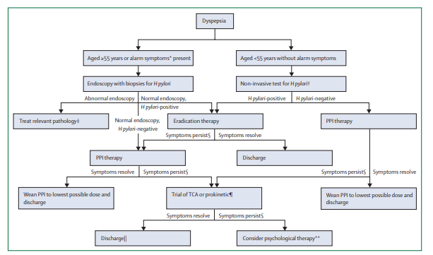
Ford et al. Lancet. 2020.

Slide 9
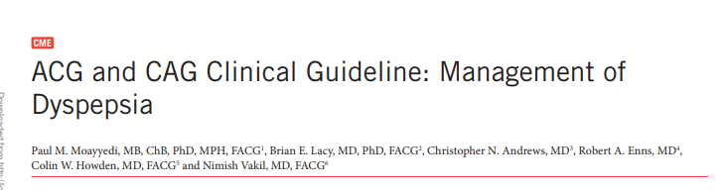
New onset over age 60 – Endoscopy to rule out Upper GI neoplasia
Under age 60 – non-invasive test for H.pylori, treat if positive (Strong evidence)
Empiric therapy with PPI
Patients with PPI failure can trial:
  A prokinetic
  Tricyclic antidepressant
Patient’s who fail pharmacologic therapy should be offered psychologic therapy
Motility studies only suggested for patients with symptoms suggestive of gastroparesis

Slide 10
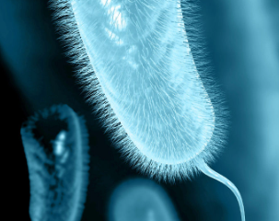
H.Pylori
H.pylori serology – can be positive forever!
ONCE TREATED YOU CANNOT ORDER SEROLOGY!
Other diagnostic options:
  Gastroscopy with gastric biopsies
  Stool Antigen (LifeLabs will do, costs ~189$)
  Urea breath test (Paused during COVID, also $$)

Slide 11
Why PPIs in FD?
We don’t understand pathophysiology
Some evidence of delayed duodenal clearance of acid or duodenal hypersensitivity to gastric acid
In addition to other motility, inflammatory, bacterial causes likely
Evidence is for once daily use
  If insufficient can increase to twice daily
  When improved try to reduce to lowest effective dose
Ford et al. Lancet. 2020.

Slide 12
What about Prokinetics?
Some not available in Canada (Cisapride, Acotiamide)
Buspirone (5-HT-1A agonist) – causes fundal relaxation
  Start 5mg HS, work up to 10-15mg TID
Ford et al. Lancet. 2020.

Slide 13
Other Treatment Options
Tricyclics (Amitryptilene, Imipramine)
  Start at 10-25mg HS, titrate up to 50mg HS
  Dry mouth, drowsiness most common side effects
SSRIs – evidence not great
Mirtazapine – 15mg up to 30mg HS – may have some effect
Cognitive Behavioural Therapy or Hypnotherapy
Ford et al. Lancet. 2020.

Slide 14
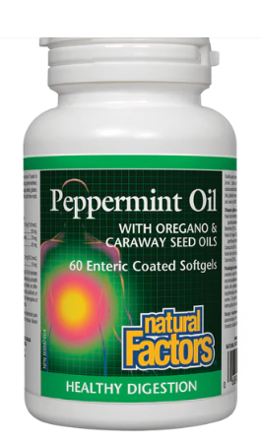
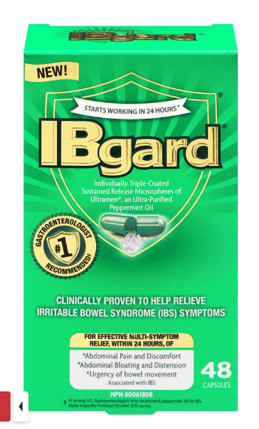
Complementary & Alternative Options
Some small scale evidence
Peppermint Oil + Caraway Oil
  Shown to reduce hyperalgesia, have antispasmodic and promotility effects
  Can cause heartburn
  Can also take as tea
Ford et al. Lancet. 2020.

Slide 15

What about Diet?
No evidence
Some overlap with non-gluten wheat sensitivity
  Some evidence that wheat proteins can induce inflammation
Some overlap with IBS and can employ a low FODMAP1diet
Ford et al. Lancet. 2020.
Zevallos VF. et al. Gut. 2023

Slide 16
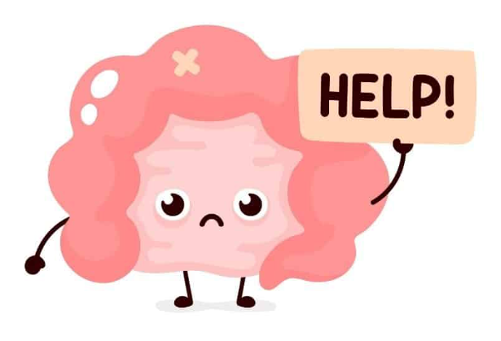
IRRITABLE BOWEL SYNDROME
(IBS)

Slide 17
Rome IV Criteria for IBS
Recurrent abdominal pain
at least 1 day/week (on average) in the last 3 months
associated with ≥ 2 of the following:
Related to defecation
Associated with a change in frequency
of stool
Associated
with a change
in form (appearance)
of stool
Criteria fulfilled for the last 3 months with symptom onset
at least 6 months prior to diagnosis
Lacy BE, Mearin FC, et al. Gastroenterology 2016; 150: 1393-1407

Slide 18
IBS – PEARLS
Positive diagnosis is important ‘You have IBS’
It is not ‘in your head’,
We DO know what is causing it but in 2023, there is no one miraculous pill to fix it
Supportive listening, acknowledge how much it affects their quality of life
Previous negative investigations? Less than 5% of them will ever have a new organic diagnosis in the future
El-Serag HB, Pilgrim P, Schoenfeld P. Systemic review: natural history of irritable bowel syndrome. Aliment Pharmacol Ther. 2004;19(8):861-870

Slide 19
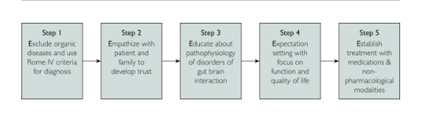
PATIENT APROACH –the 5 E’s
Tome J et al. Mayo Clinic Proceedings. 2023. 98(3)

Slide 20
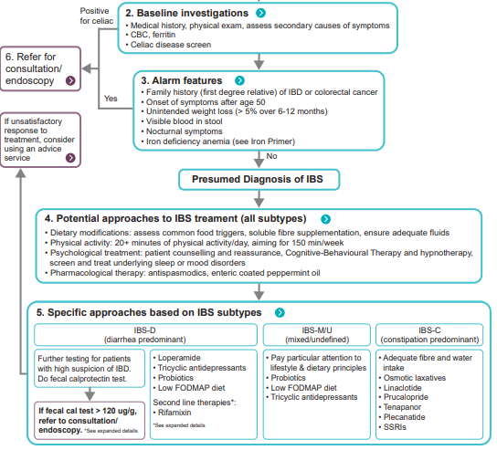


Slide 21
IBS - Management
Non pharmacologic therapy
  Exercise – increases well-being, reduces pain receptor sensitivity
  Mindfulness – coping strategies
  Sleep
Complementary Therapies
  Peppermint Oil Capsules – good for spasm, TID prn
  Curcumin 1g BID – likely some benefit, studies small, not statistically significant
Soluble Fibre (e.g. Metamucil)
  Better in diarrhea
  Start low, go slow – aim is extra 10g a day to see effect (~ 3 TBSP daily!)
  Explain the reasoning, start at 1tsp daily and slowly titrate up

Slide 22
IBS – D: Management
Scheduled Loperamide (eg. 2mg with meals)
Anti-spasmodics
  Hyoscine (Buscopan)
  Trimebutine (Modulon)
  Pinaverium (Dicetel)
  Dicyclomine (Bentylol)
Motility reducers
  Eluxadoline (Viberzi) 100mg PO BID (avoid if CCY or hx of pancreatitis)
Neuromodulators
  Tricyclic Antidepressants (Amitriptyline, Imipramine)
Antibiotics
  Rifaximin 550mg PO TID x 14 days

Slide 23

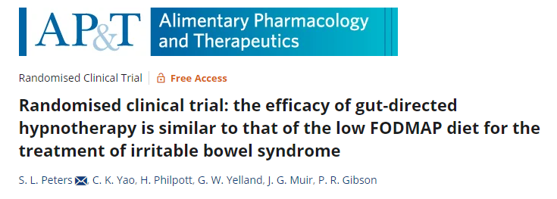


Slide 24
CHRONIC CONSTIPATION (CIC)
&
CONSTIPATION-PREDOMINANT IBS (IBS-C)

Slide 25
They exist on a continuum
CIC
IBS-C
Low Abdominal Pain
High Abdominal Pain
Pain is an important therapeutic target to manage
Notes:
CIC and IBS-C are often thought of as a continuum of constipation, with CIC on the lower range of abdominal pain and IBS-C associated with greater abdominal pain. Pain, therefore, becomes an important target when managing patients with constipation

Slide 26
1st Line Approaches - CONSTIPATION
Bowel hygiene
  Sit quietly after a meal or coffee
  When you get the urge, go immediately
Daily exercise
Regular hydration
Dietary laxatives
  Prunes, Grapes, Coconut, Pineapple
Osmotic Laxatives
  PEG3350, Lactulose

Slide 27
NEW PHARMACOLOGIC APPROACHES
Guanylate Cyclase C Activator – Increases cGMP levels
  Linaclotide (Constella) 72ug, 145ug, 290ug daily on empty stomach
  Plecanatide (Trulance) 3mg once daily with or without food
NH3 inhibitor
  Tenapanor (IBSrela) 50mg BID

Slide 28

What about diet?
Many unknowns
Did you know that some proteins in wheat (ex. Amylase trypsin inhibitors) can induce a form of MS in mice by upregulating the immune system?
Low FODMAPS diet is still the gold standard
Access to a dietician/support is key if available:
  https://ibsnutrition.com
  www.katescarlata.com
  thetummyclinic.ca
Zevallos VF. et al. Gut. 2023

Slide 29
RECAP
What are Disorders of Gut-Brain Interaction (DGBI)?
Acknowledge the huge unknowns in the world of DGBI
Update in Functional Dyspepsia
Update in Irritable Bowel Syndrome
Update in Chronic Constipation
What about Diet?

Slide 30
Questions?

