Slide 1
Rosemary C. Polomano, PhD, RN, FAAN
Professor of Pain Practice
University of Pennsylvania School of Nursing
Professor of Anesthesiology and Critical Care (Secondary)
University of Pennsylvania Perelman School of Medicine
Claire M. Fagin Hall 418 Curie Blvd
Philadelphia, PA 19104
E-mail: polomanr@nursing.upenn.edu
How Good is Your Intervention?
Notes:
Changed the title to Academic Practice Partnership

Slide 2
How Are Your Going to Change After this Presentation?
Hopefully whenever someone tells you that an intervention is evidence-based, you are going to ASK:
  For WHO? (Population or People)
  For WHAT 1? (Condition/Illness/Disease/Symptom, Events………)
  For WHAT 2? (Outcome)
  For WHEN? (Timing)
  For WHERE? (Setting, Circumstance)
  For HOW? (Nature, Delivery of the Intervention)

Slide 3
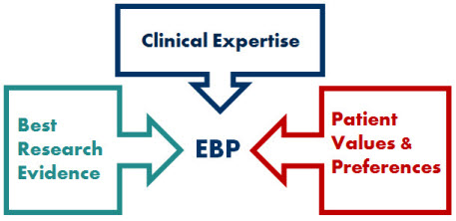
What is “Evidence-Based Practice”?
Evidence-Based Practice
“Integration of best research evidence with clinical expertise and client values”
Sackett D, et al. Evidence-based medicine. How to practice and teach EBM (pp. 4). London: Churchill Livingstone, 2000.

Slide 4

Stressed and Steeped in Tradition
http://thehealthfiles.wordpress.com/

Slide 5
How Do We know How Good an Intervention Is?
Strength of the Evidence
Effect Size (ES)
Numbers Needed to Treat (NNT)
Numbers Needed to Harm (NNH)

Slide 6
EBP is based on evidence
Levels of
Evidence
        Statistically pools results from previous studies into single quantitative analysis
        Allows for application of scientific criteria
A systematic review is secondary research that seeks to collate all primary studies that fit prespecified eligibility criteria in order to address a specific research question (https://handbook-5-1.cochrane.org/)
Meta-
Analyses
Systematic
Reviews
Well-designed
Experimental Studies (RCTs)
Well-designed
Nonexperimental Studies
Observational Descriptive Studies
Expert Consensus
Published Case Reports and Clinical Examples
Scientific evidence or consensus-based evidence

Slide 7
The Strongest Level of Synthesis: A Meta-Analysis
An exhaustive review of the literature
An integration of results to:
  Examine research studies and pool data for statistical analyses
  Formulate statistical conclusions about contradictory research-based information
  Answer important questions about practice
  Generalize conclusions

Slide 8
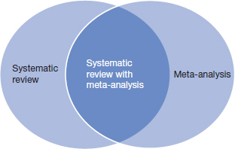
Meta-analyses and Systematic Reviews
JAMA Users guide to the medical literature, 3rd edition. Figure 22-1.

Slide 9
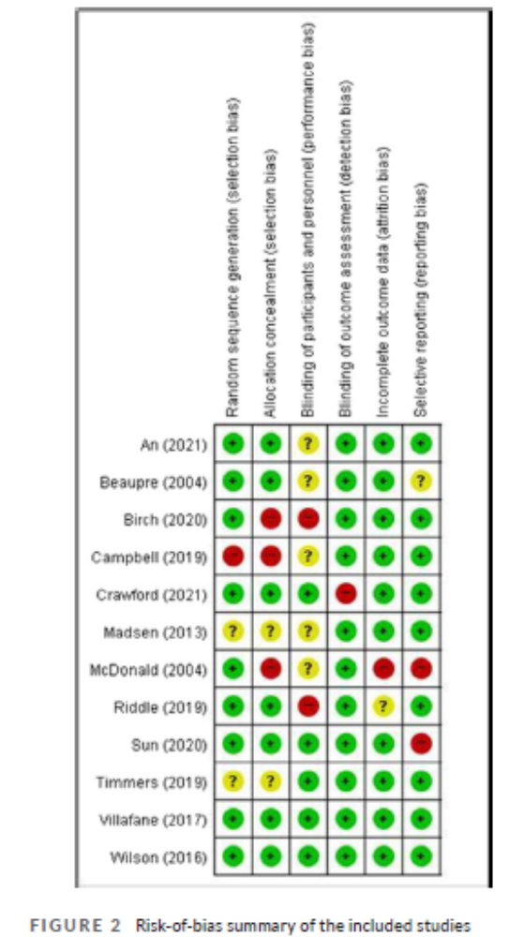

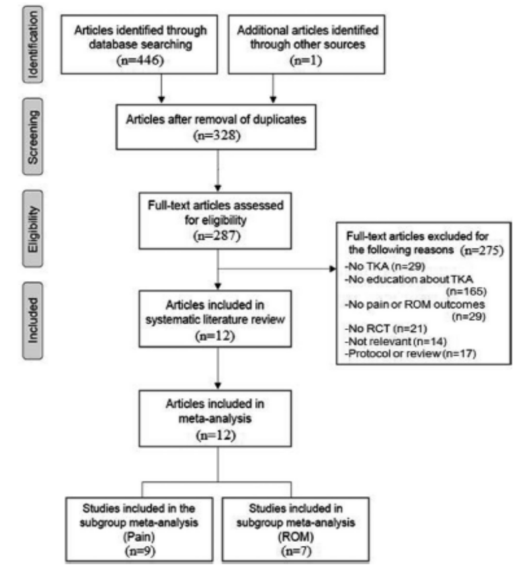
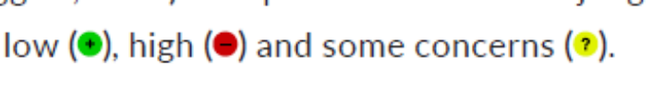
Quality of a Meta-analysis and Systematic Review
PRISMA Flow Diagram
Effect size (small, medium, large)
Risk of Bias
Forest Plot
Evidence Table

Slide 10
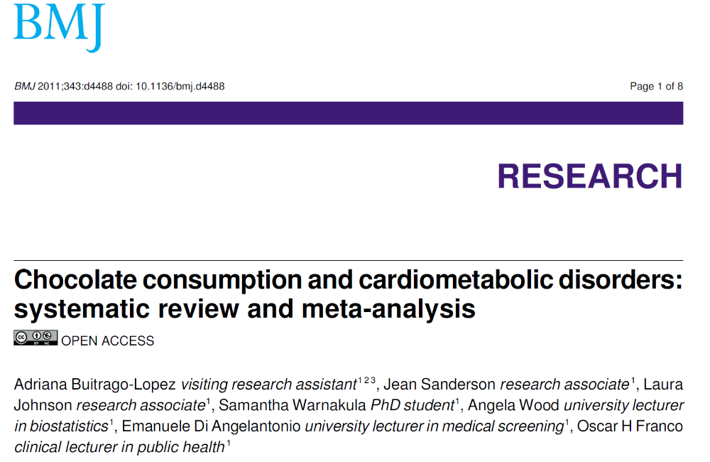

Slide 11
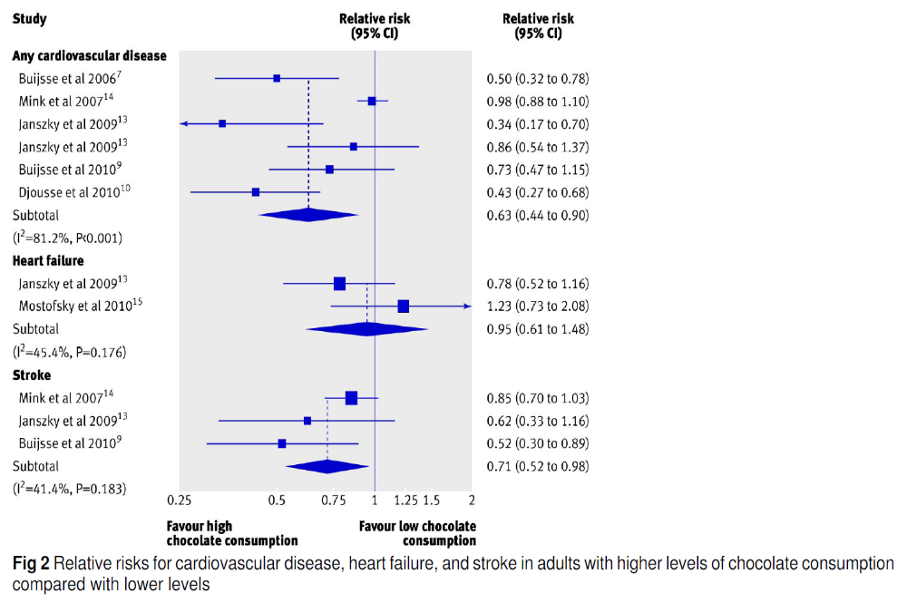



Slide 12
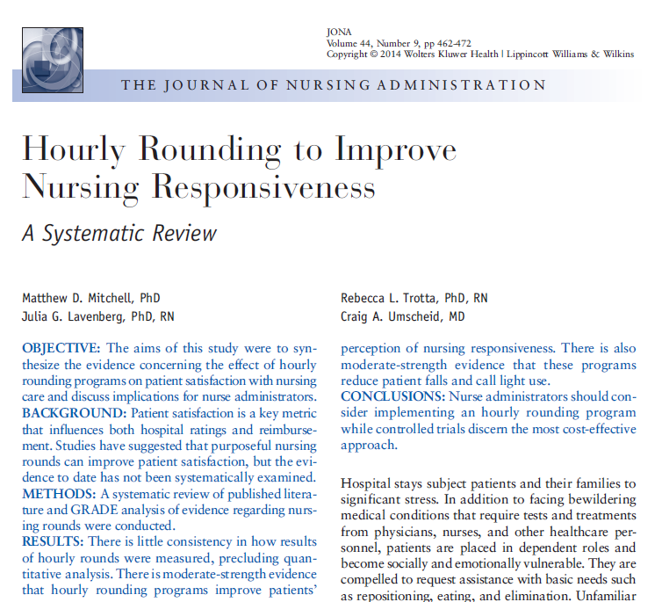

Slide 13
How Do We know How Good an Intervention Is?
Strength of the Evidence
Effect Size (ES)
Numbers Needed to Treat (NNT)
Numbers Needed to Harm (NNH)

Slide 14
Effect Size (ES): It is th size of the treatment/intervention effect
Tells you how meaningful the relationship between variables or the difference between groups is
It indicates the practical significance of a research outcome
A large effect size means that a research finding has practical significance, while a small effect size indicates limited practical applications
Bhandari, P. (2023, June 22). What is Effect Size and Why Does It Matter? (Examples). Scribbr.
Retrieved February 24, 2025, from https://www.scribbr.com/statistics/effect-size/

Slide 15
Cohen’s Effect Sizes for the Magnitude of the Treatment Effect (d)
Small = .2
Medium = .5
Large = .8
How do you get it? Looking at prior studies is the best bet, and meta-analyses and systematic reviews. Randomized controlled trails (RCTs) also report effect sizes.
  Estimate it
  Looking at prior studies
  Calculate it in the analysis of the study with the study data
Effect sizes are used to calculate sample sizes

Slide 16
Does the ES differ by an intervention? YES
Aroma Therapy:
  For WHO?
    Postoperative patients
  For WHAT 1? (Condition/Illness/Disease/Symptom, Events………)
    Type of surgery
  For WHAT 2? (Outcome)
    Frequency or severity
  For WHERE? (Setting, Circumstance)
    Post-anesthesia Care Unit
    General Care Unit
  For HOW? (Nature and Delivery of the Intervention)
    Ginger, lavender, and peppermint essential oils
    Inhalation method

Slide 17
Is Aromatherapy Vs. Music Therapy Evidence-based? (Population, Setting, Condition, Outcome)
Aromatherapy for Agitation with Dementia in Older Adults: Not effective!
Backhouse, T., et al. (2020). Strategies and interventions to reduce or manage refusals in personal care in dementia: A systematic review. International Journal of Nursing Studies, 109, 103640.
Livingston, G., et al. (2014). Non-pharmacological interventions for agitation in dementia: Systematic review of randomised controlled trials. The British Journal of Psychiatry: The Journal of Mental Science, 205(6), 436–442.
Millán-Calenti, J. C., et al. (2016). Optimal nonpharmacological management of agitation in Alzheimer's disease: Challenges and solutions. Clinical Interventions in Aging, 11, 175–184.
***Systematic Review: Not superior to placebo
Music Therapy for Agitation in Adults: Is effective!
Sisti, A., et al. (2024). Using structured observations to evaluate the effects of a personalized music intervention on agitated behaviors and mood in nursing home residents with dementia: Results from an embedded, pragmatic randomized controlled trial. The American Journal of Geriatric Psychiatry, 32(3), 300–311.
Bleibel, M., et al. (2023). The effect of music therapy on cognitive functions in patients with Alzheimer's disease: A systematic review of randomized controlled trials. Alzheimer’s Research & Therapy, 15(1), 65. ***Greater effect was shown when patients are involved in the music making when using active music intervention.

Slide 18
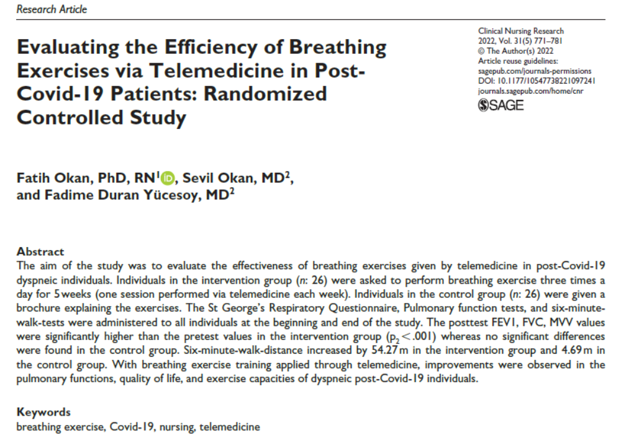
Let’s walk through an example research article

Slide 19
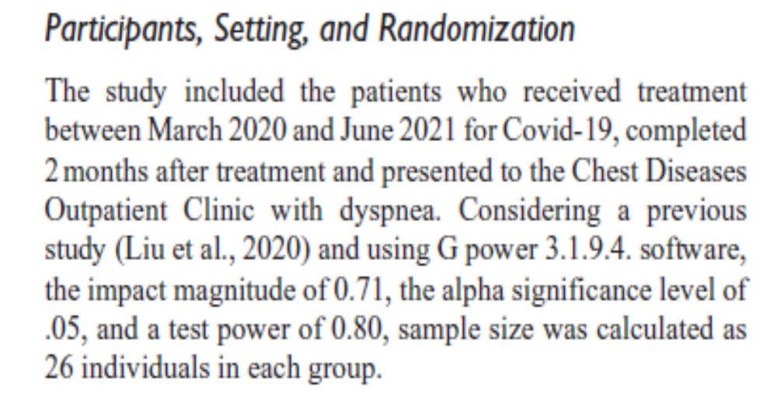
Cohen’s Effect Sizes for the Magnitude of the Treatment Effect
Here is the power analysis in our study.
What size is this?
The Effect Size (ES) of intervention measures how good the intervention is
  The bigger the ES, the better the intervention
ESs are used to determine sample sizes
  The bigger the ES, fewer participants are needed in a study
  The smaller the ES, more participants are needed in a study
THINK: The better the intervention, the more likely you will be able to see a treatment difference
ESs are typically estimated as:
  Small = .2
  Medium = .5
  Large = .8

Slide 20
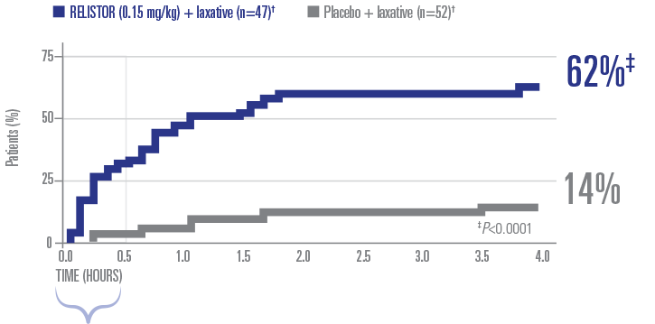
Example from a Study of a drug for Opioid-induced Constipation (Single-Dose Study):
62% Responded to RELISTOR Within 4 Hours*
Look at how big the difference is between groups
Look at small the sample sizes for the groups.
Would you say this is a small of large ES?
~50% of patients who responded under 4 hours reported a BM* within 30 minutes of the first RELISTOR subcutaneous injection
*A BM that did not require rescue laxative or disimpaction.
†Baseline laxatives were used by 96% of patients. Baseline characteristics were well balanced among the treatment groups.
Slatkin N, et al. J Support Oncol. 2009;7(1):39-46.
Notes:
Notes
In this single-dose study, 62% of patients treated with RELISTOR 0.15 mg/kg reported laxation within 4 hours of study drug, compared with 14% with placebo (P<0.0001).
The median time to laxation was 1 hour with RELISTOR 0.15 mg/kg and >24 hours with placebo (P<0.0001).
[slide build] Approximately 50% of responders reported a bowel movement within
30 minutes of dosing.
Reference:
Slatkin N, Thomas J, Lipman AG, et al. Methylnaltrexone for treatment of opioid-induced constipation in advanced illness patients. J Support Oncol. 2009;7(1):39-46.
Slatkin 2009 P 44, figure 3 [A]
Slatkin 2009 P 42, col 1, para 1, lines 1-4 [C]
Slatkin 2009 P 42, col 1, last para, lines 1-2 to col 2 para 1, Lines 1-4 [B]
Slatkin 2009 P 42, col 2 para 1, last 3 lines [D]

Slide 21
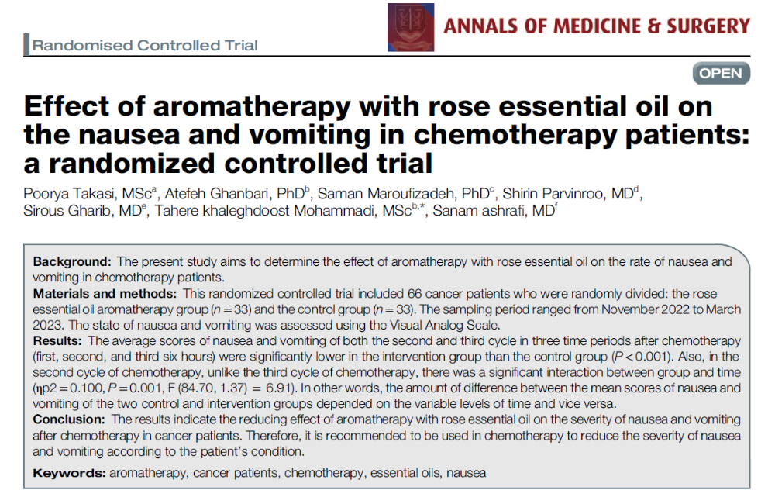
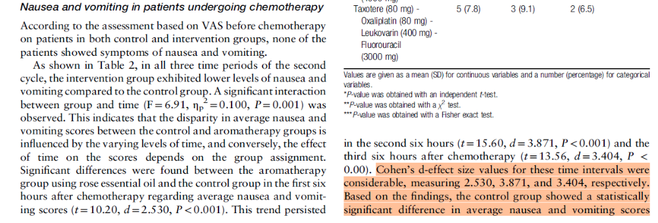

Slide 22
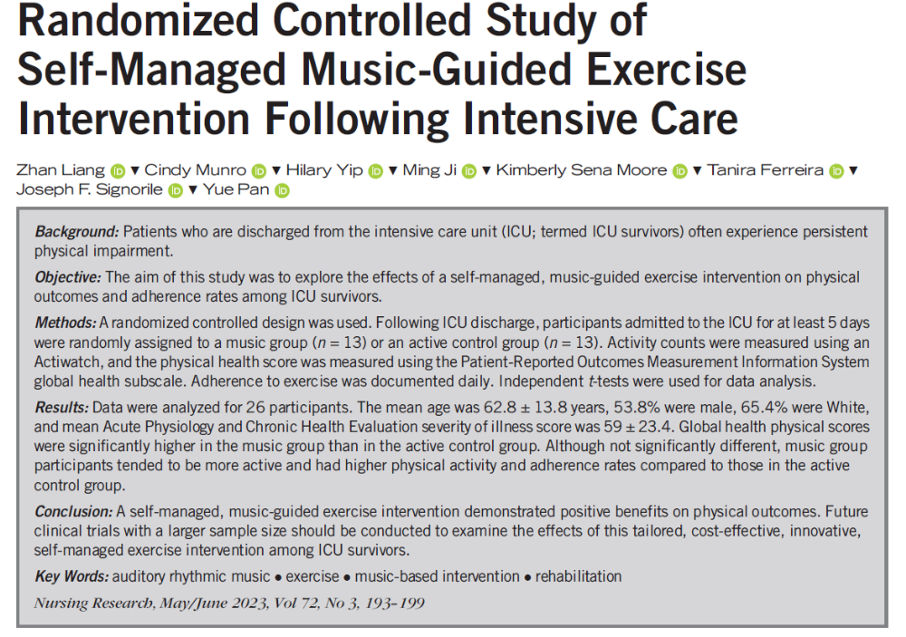
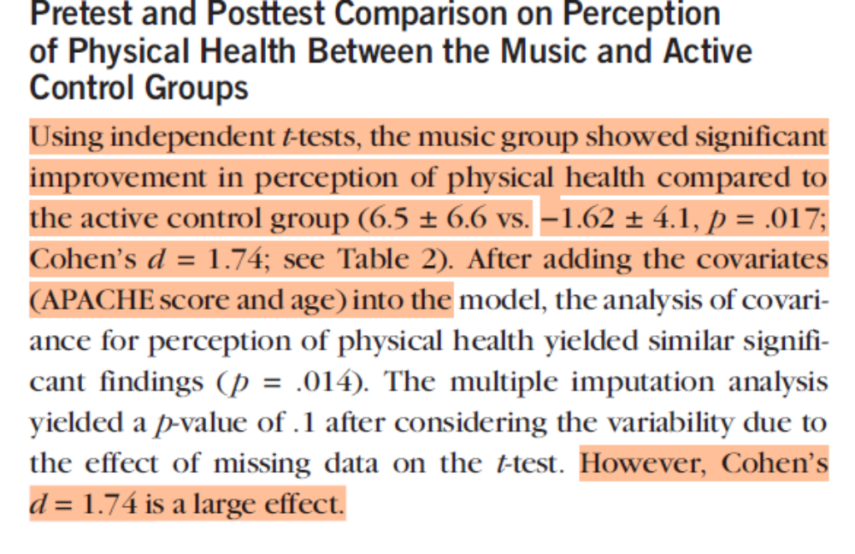

Slide 23
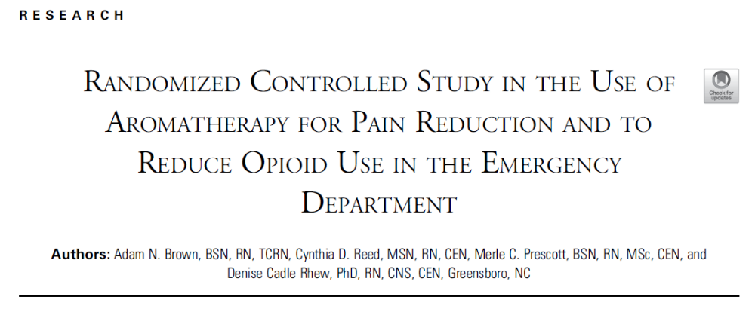
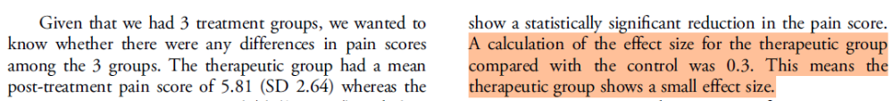

Slide 24
How Good is an Intervention?
What do you do when you go to give a medication/intervention, and the patient asks – Is this going to work?

Slide 25
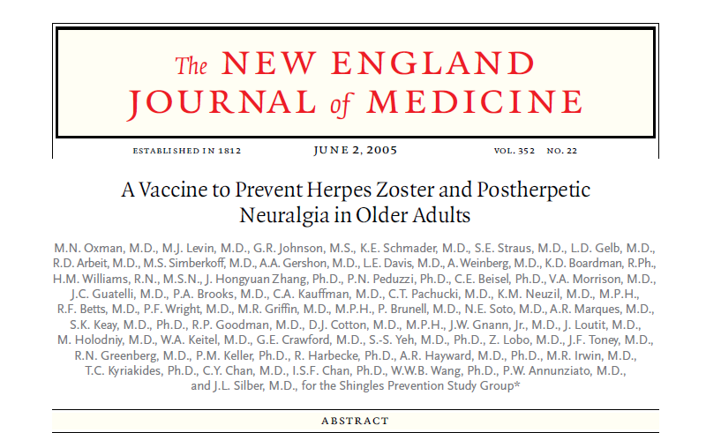

Slide 26
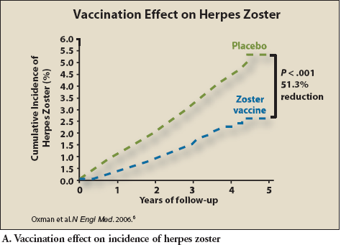
Kaplan-Maier Curves for Probability

Slide 27
How Do We know How Good an Intervention Is?
Strength of the Evidence
Effect Size ES)
Numbers Needed to Treat (NNT)
Numbers Needed to Harm (NNH)

Slide 28
Number Needed to Treat (NNT)
Estimate of how many people you would need to receive the intervention to obtain a positive or desirable outcome
Google AI Definition: "Numbers needed to treat" (NNT) refers to the average number of patients that need to be treated with a specific intervention (like a medication) to prevent one additional negative outcome compared to a control group, essentially measuring how effective a treatment is in a clinical trial; a lower NNT indicates a more effective treatment.”

Slide 29

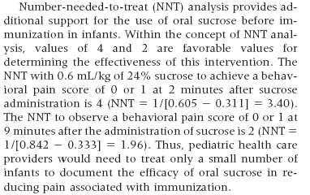

Slide 30

Implications for Practice
Numbers Needed to Treat (NNT)
2 Minutes
NNT = 1/(0.61-0.31) = 3.40
9 Minutes:
NNT = 1/(0.84-0.33) = 1.96
The Commonwealth Master of Public Health Program. http://www.commonwealthmph.org/forms.html. February 21, 2005

Slide 31
How Do We know How Good an Intervention Is?
Strength of the Evidence
Effect Size (ES)
Numbers Needed to Treat (NNT)
Numbers Needed to Harm (NNH)

Slide 32
Number Needed to Harm (NNH)
Number needed to harm (NNH): A calculation that shows how many people need to be given the intervention to cause harm for one person
Very important for interventions such as vaccines

Slide 33
Google NNH for Statins
The number needed to harm (NNH) for statins varies depending on the adverse event, but is generally between 21 and 204 people
This means that for every 21 to 204 people treated with statins, one person will experience an adverse event
Risk/Benefit: Treating 1000 patients with a statin would prevent 37 cardiovascular events, and 5 AEs would be observed
(Silva MA, et al. Statin-related adverse events: a meta-analysis. Clin Ther. 2006;28(1):26-35.)

Slide 34
What vaccine would you have wanted to know the NNH?

Slide 35


Slide 36
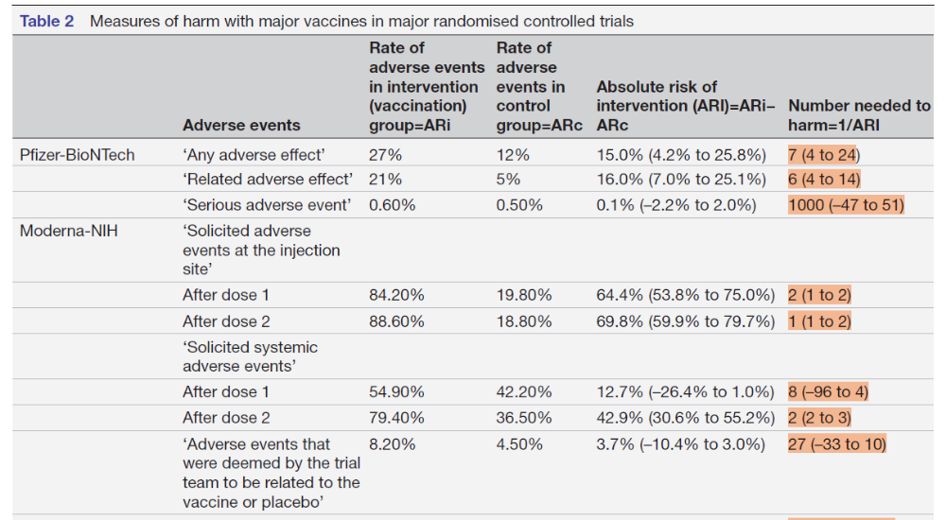

Slide 37
Simple Linear Regression
In summary, there are many parameters that tell us how good an intervention is
Because an intervention works in one group, setting, or condition does not mean that it will apply to other populations or situations
Strength of evidence and ES are the most common ways that we determine how good an intervention is
Always ask a researcher or statistician to help you interpret how good an intervention might be

Slide 38

Simple Linear Regression

